Slide 1



BWIA121 Financial calculator
Jaun Minnaar
50915088
B.Sc. Financial maths

Slide 2
Capabilities of my calculator
Interest conversions
Getting constant interest through a period of changing interests
Single investment growth with graphs
Comparing two single investments
Annuities with graphing and an amortization table
Loans with an amortization table
Increasing annuities with the capability of calculating a retirement plan
Real rates

Slide 3
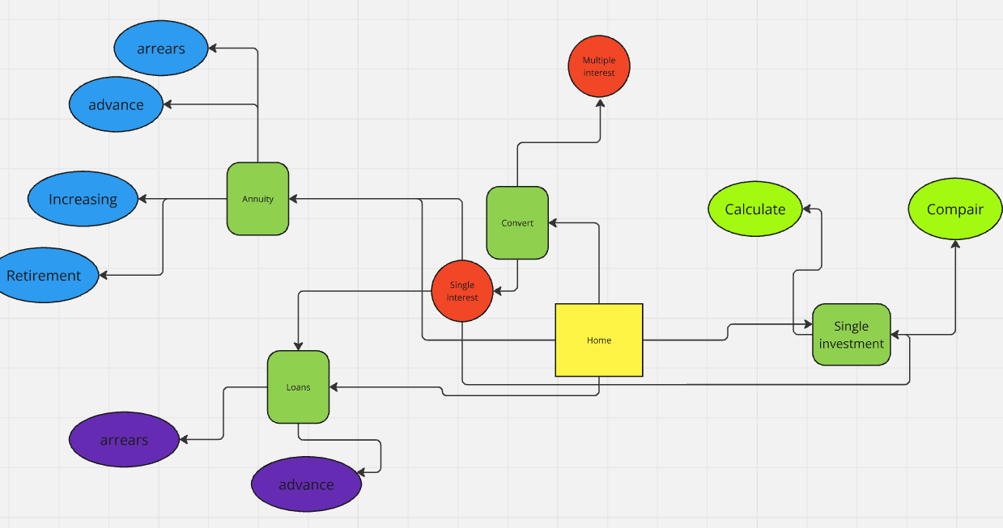
Flow of my calculator

Slide 4

Converter page
Functionality
My converter is built on a user form. This makes it accessible from every page without having to navigate away from that page
The page can convert any interest to any other type of interest
You can also convert multiple interest rates over a period to the effective interest rate of the period with the “convert changing interests”-tab
I also built a dynamic timeline into this worksheet

Slide 5

Single investment page
Functionality
Convert a single amount to: Present value, Future value, time of investment and interest
Dynamic graph of the future value over time
Comparison between two investments
Comparison between the real rate of the investment and nominal rate of the investment
A graphic representation of what would happen to your money over time if you do not invest

Slide 6

Annuity
Functionality
Get the FV, PV, Interest, payment, and time of the annuity
Calculate annuity in arrears and advance and increasing
A dynamic table of the FV is generated. Specific values can be read out of the table with a spin button.
A graph can be generated and closed with the click of a button by the user
A retirement page is added to calculate a retirement plan

Slide 7

Loans
Functionality
Calculate the loan amount, repayment amount, last payment amount, and the time of the loan
Dynamic amortization table, which is scrollable is added to the page
Interest, capital can be calculated at a time, over a time, or the total, with a spin button

Slide 8
End
BWIA 121
Financial calculator
Jaun Minnaar
50915088
B.Sc. Financial mathematics

